Slide 1

The State Innovation Model Grant:
The Importance of the SIM Grant to Maine
Mary C Mayhew
Commissioner, Maine DHHS

Slide 2
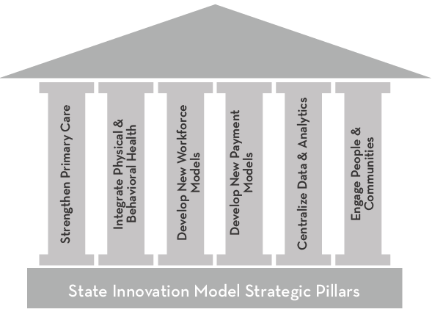

The Importance of SIM to Healthcare Transformation in ME
The six strategic pillars of the State Innovation Model (below) are each comprised of individual objectives that are aligned to effect meaningful change in our healthcare system.
Transformed Healthcare System

Slide 3
SIM Year One Accomplishments
Strengthen Primary Care
Primary Care Practice Reports and training to 432 practices, with the intent of data-driven practice improvement
Automated Emergency Room Notifications to MaineCare Care Management teams implemented
Accountable Communities established for MaineCare population
Up to 40 new MaineCare Health Home practices added in ‘14
Health Homes Learning Collaborative training sessions held
Integrate Physical & Behavioral Health
25 Behavioral Health Homes (BHH) formed in 2014, and BHH Learning Collaboratives held over course of year
20 BHH practices selected to receive HIT grants and testing successfully completed on the HIE
Ability for BHH to access population-based data on MaineCare portal dashboard
Notes:
Dr Flanigan

Slide 4
SIM Year One Accomplishments
Develop New Workforce Models
Community Health Workers pilots contracted and activity underway, including defined roles and responsibilities
Integrated physical/behavioral health training curriculum developed and advanced
Develop New Payment Models
Value Based Insurance Design workplan was established to promote broader understanding and adoption of this arrangement
Total Cost of Care and quality reports developed to drive accountability targets at practices
Public reporting capabilities enhanced and advanced
Contracts with 5 Accountable Communities well underway
5 National Diabetes Prevention Program sites selected and intiatives well underway
Notes:
Dr Flanigan

Slide 5
SIM Year One
Accomplishments
Data Resources & Analysis
Cost of Care Program Role driving cost of care discussions throughout the State
Maine’s HealthCare Cost Factbook released
Clinical Dashboard development progressed well
HIN ER notification system implemented
Engage People & Communities
Patient Provider Partnership Pilots launched and implemented
National Diabetes Prevention Program and Community Health Workler sites launched
Value Based Insurance Design trainings held with Area Agencies on Aging
Value Based Insurance Design video script drafted
Notes:
Dr Flanigan

Slide 6
The Next 12 Months
Continued Implementation of MaineCare ACCs/ACOs
Public reporting of Behavioral Health and Health System metrics
Continued learning sessions with P3 Pilots, PCMH practices, HH practices, and BHH organizations
Implementation of MaineCare Clinical Dashboard
Operationalization of ER Notification System
Digesting early results and perhaps correcting course…
Notes:
Dr Flanigan

Slide 7
SIM Publically Reported Measures
Coming Soon
Core Measures
Non-Emergent ED Use | Imaging Overuse | Fragmented Care
All Cause Readmissions | Total Cost of Care | Well-Child Visits
Developmental Screenings | Follow-Up After Hospitalization for Mental Illness | Clinical Depression Screening and Follow UP
Patient Experience Measures | Adult BMI | Weight Assessment
Diabetic Care | Adults meeting physical activity guidelines
Notes:
Randy
These are the core metrics that will become part of the SIM Core Dashboard
The plan is to ‘unveil’ the prototype in the Dec 14/Jan 15 timeframe.
While these metric identify the core metrics, this is not all inclusive of what is being measured under SIM

Slide 8
SIM: Increasing Momentum Toward Enhancement of Primary Care
Primary care receives signficantly less than 10% of all health care spend,
but influences more than 80% of total spend.
Notes:
Stefanie
This high level graphic describes the State’s desired direction of a shift in investment toward Primary Care.
Throughout many SIM programs, this direction is reinforced and accelerated.
The State would like to see more bold, disruptive moves to accelerate this shift, though SIM and elsewhere in the HealthCare landscape.

Slide 9
Primary Care Payment Reform Acceleration – SIM can drive for Bold, Decisive Change
Primary Care Payment Reform Directional Options
Increase % of health payments spent on primary care | Institute a comprehensive primary care payment
Tie “PCP bump” funds to payment reform | Employ shared savings methodologies
Increase primary care rates based on medical home recognition | Combine patient-centered medical home (PCMH) with episodes of care
Use pay-for performance incentives
Notes:
Randy
Recently, SIM has started to facilitate a discussion w/in the SIM governance structure to look for ways to accelerate Primary Care Payment Reform
These options, most of which are occurring in various ways in other States, were pulled together by Center for Health Care Strategies (CHCS) and the State Health Access Data Assistance Center (SHADAC) out of the University of MN
Maine is receiving Technical Assistance through these entitites through our SIM grant
We intend to leverage these organizations expertise to facilitate a discussion in SIM governance regarding options that ME should be pursuing to hasten primary care payment reform

Slide 10
Questions?
Mary C. Mayhew, Commissioner
Maine Department of Health and Human Services
(207) 287-4223
Notes:
Dr Flanigan

